Slide 1



Chapter 5
Human genetics
Pedigree analysis part 2:
gene localization

Slide 2




Part 2: determining the localization of a gene.
•
Is it on the sex chromosomes Y?
•
Is it on the sex chromosome X?
•
Is it both on X and Y?
Is it on an autosome?
•

Slide 3
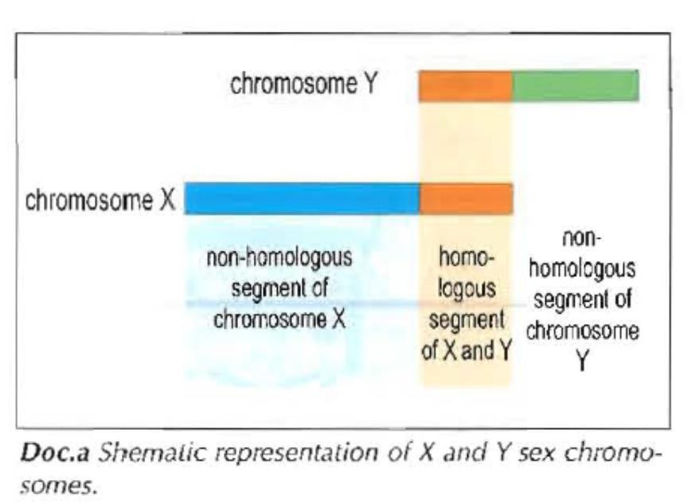
A closer look at the sex-chromosomes X and Y

Slide 4
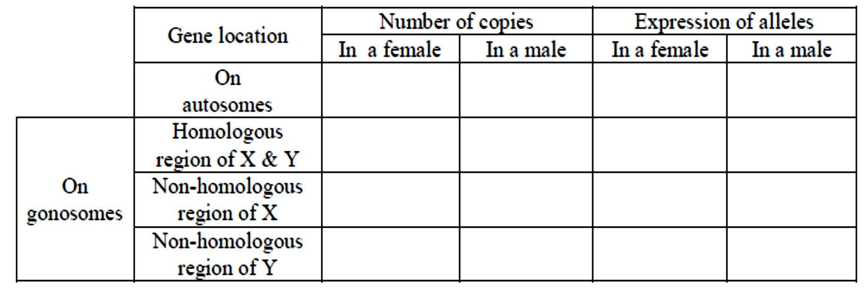














Fill in the following table:
Dominant expressed Dominant expressed
Dominant expressed
Not expressed
Dominant expressed
Dominant
expressed
Allele expressed regardless
2 | 2
2 | 2
2 | 1
0 | 1
Allele expressed regardless
Pair of
Autosomes
X X
Pair of Autosomes
X
Y

Slide 5
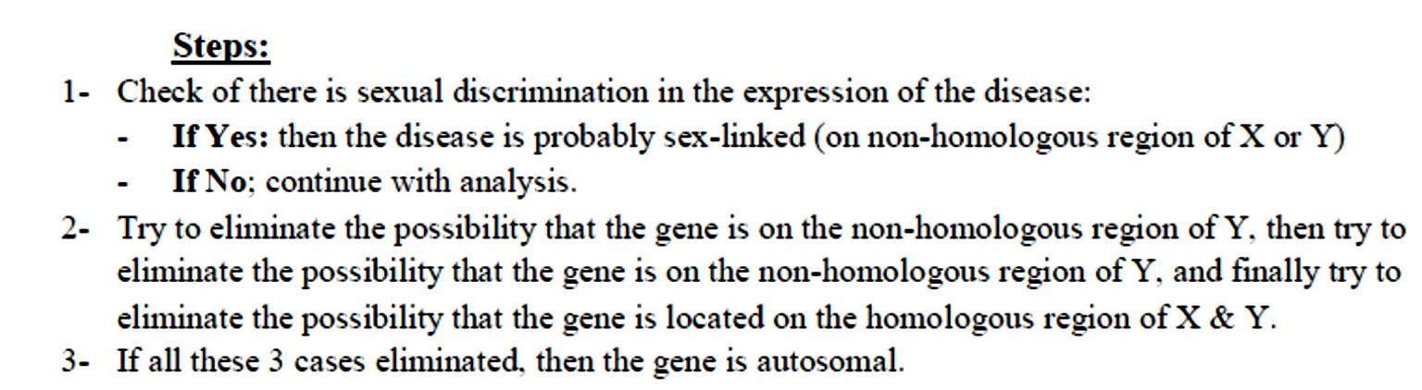

Strategy
X

Slide 6
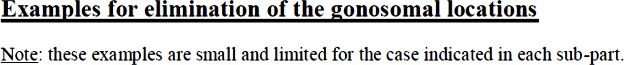
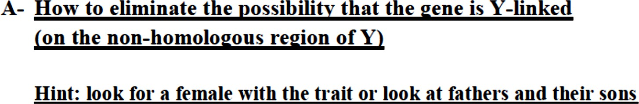



Slide 7
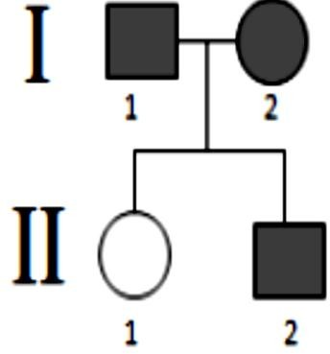
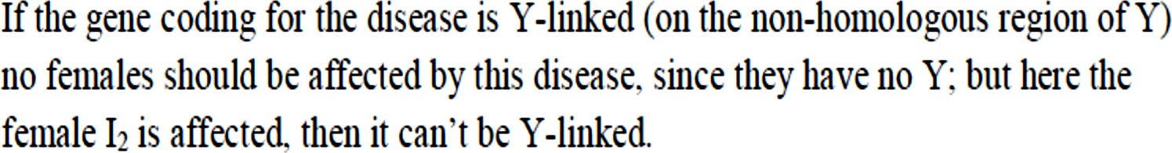

Slide 8
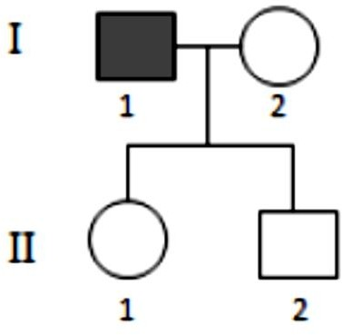
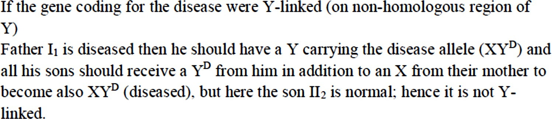

Slide 9
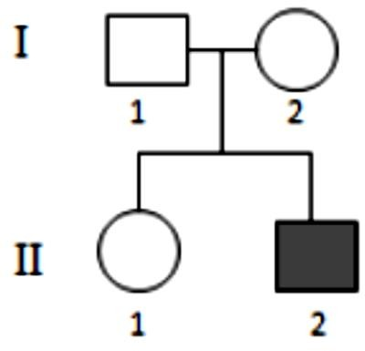
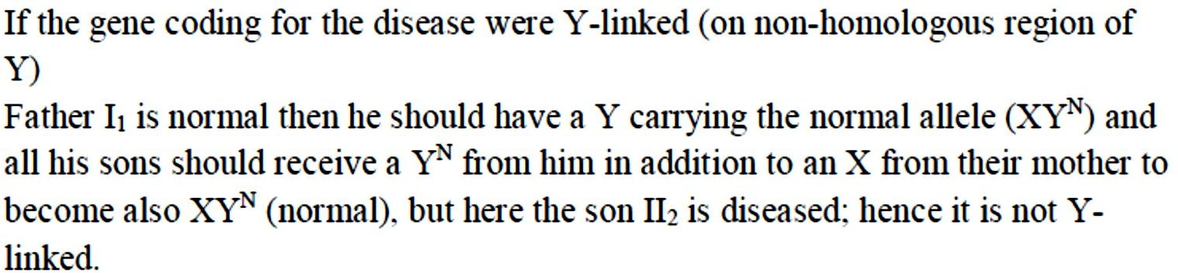

Slide 11
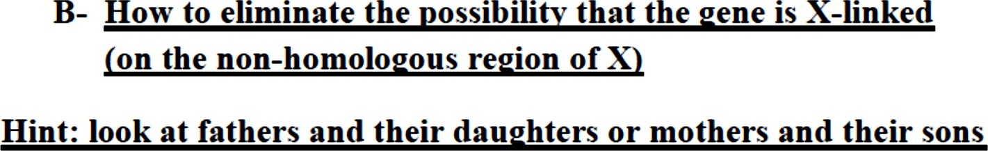



Slide 12
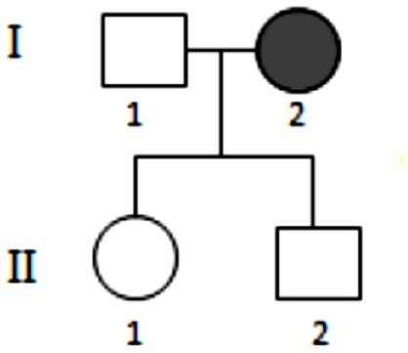
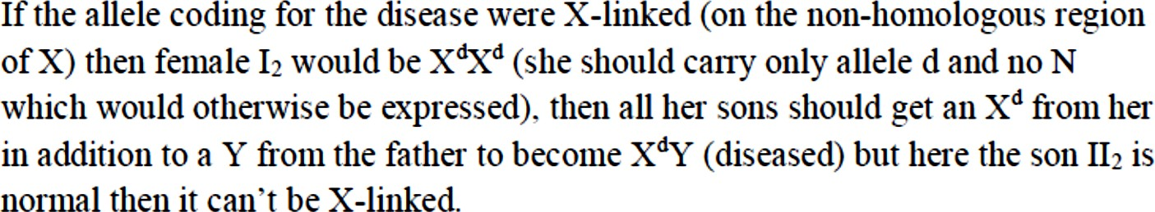
Example 1

Slide 13
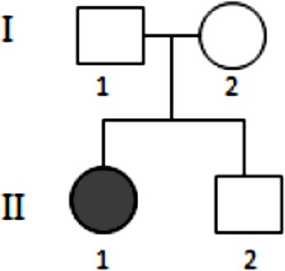
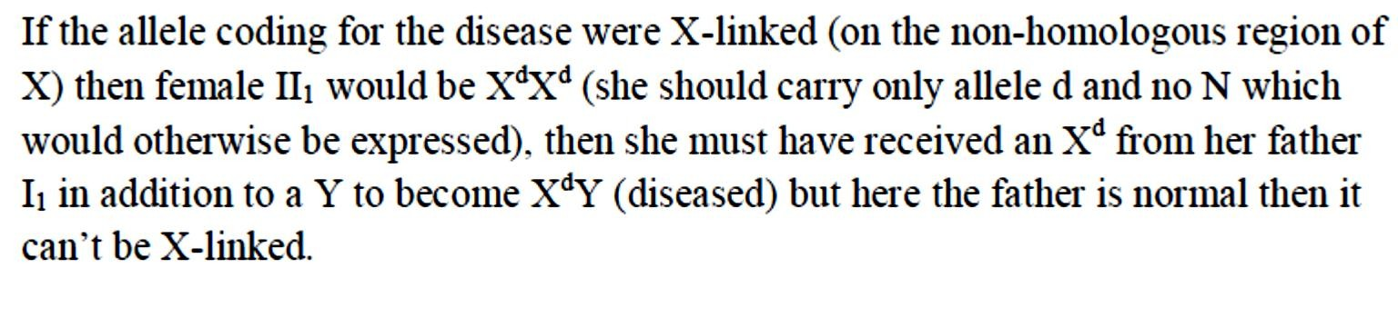
Example 2
. But then the father would be affected (X^{d}Y) and here he his normal, hence this gene

Slide 14
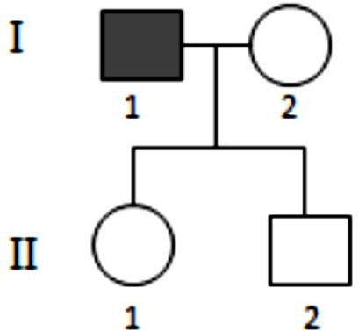
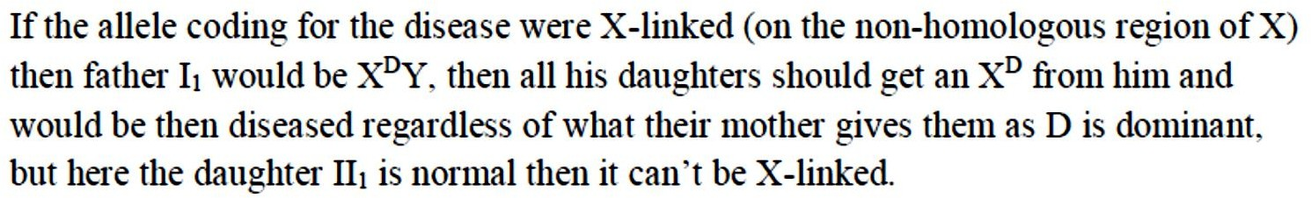
Example 1

Slide 15
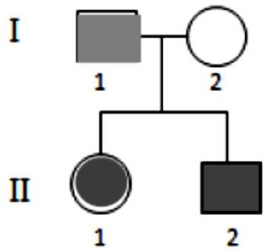
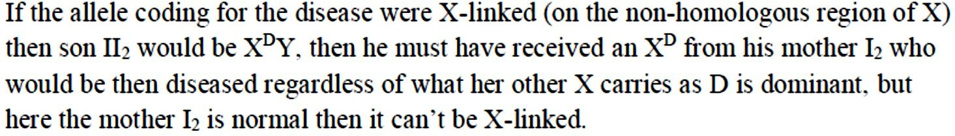
Example 2

Slide 16


Slide 17
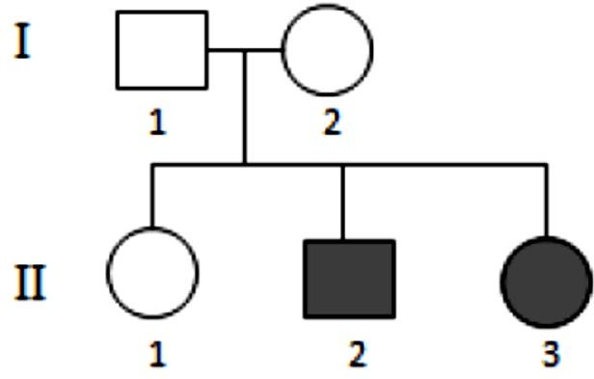
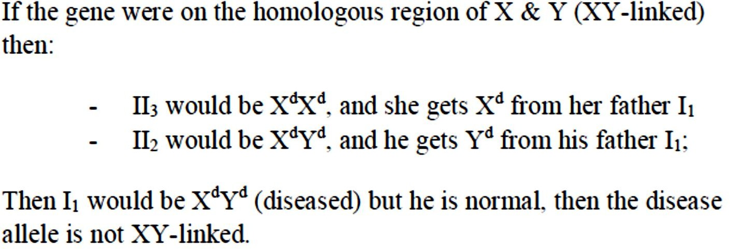

Slide 18
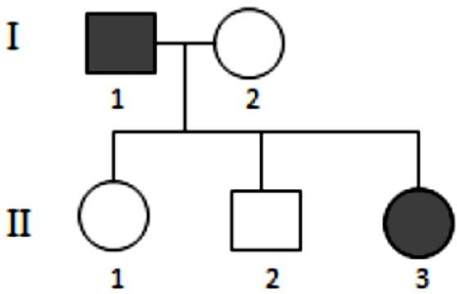
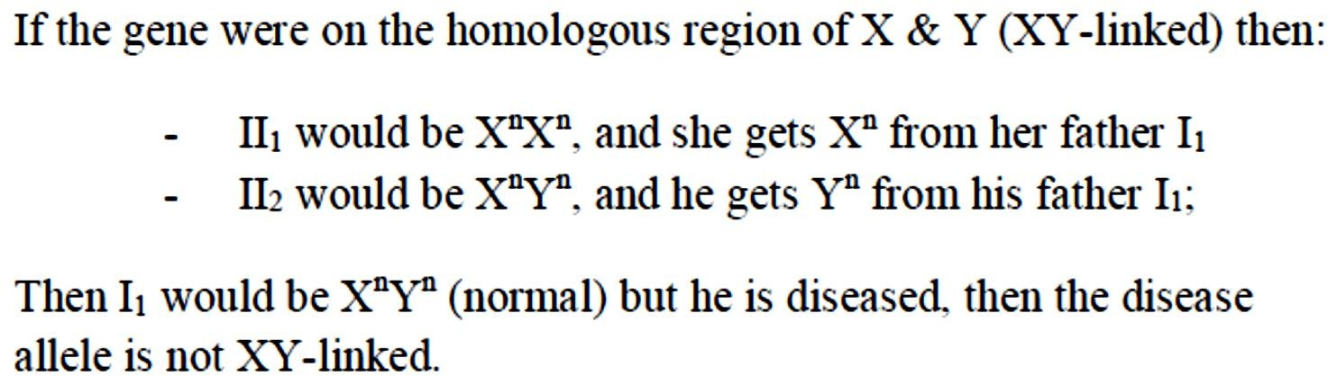

Slide 19
